Slide 1




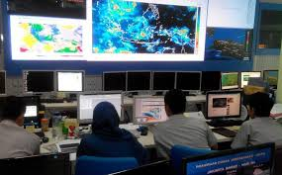
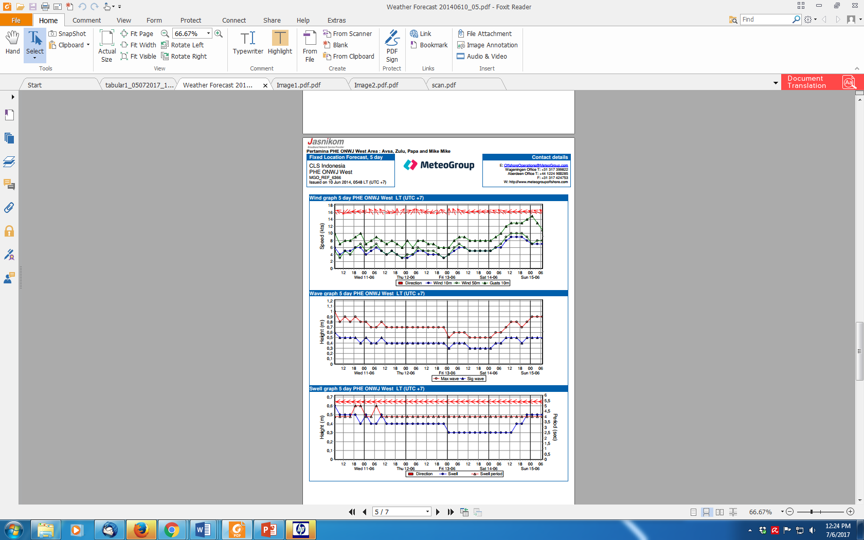
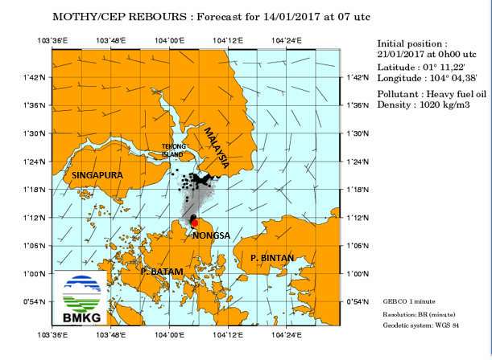
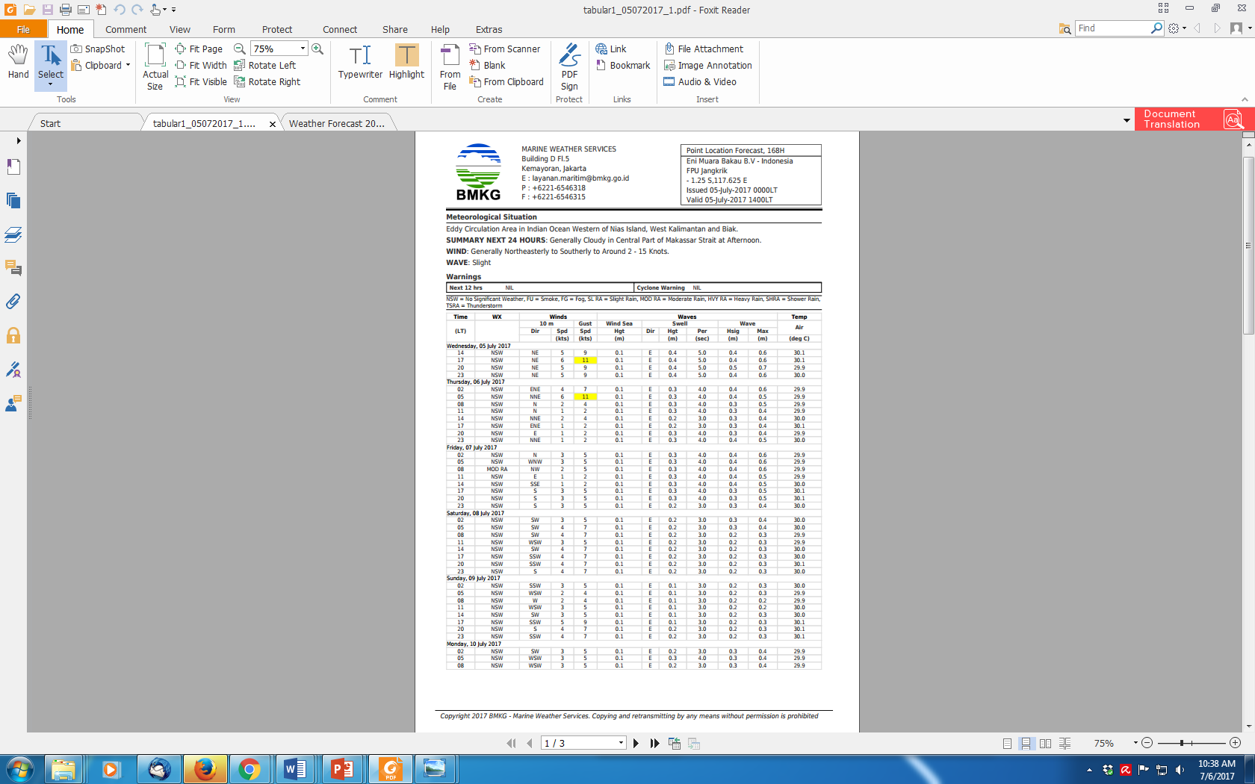
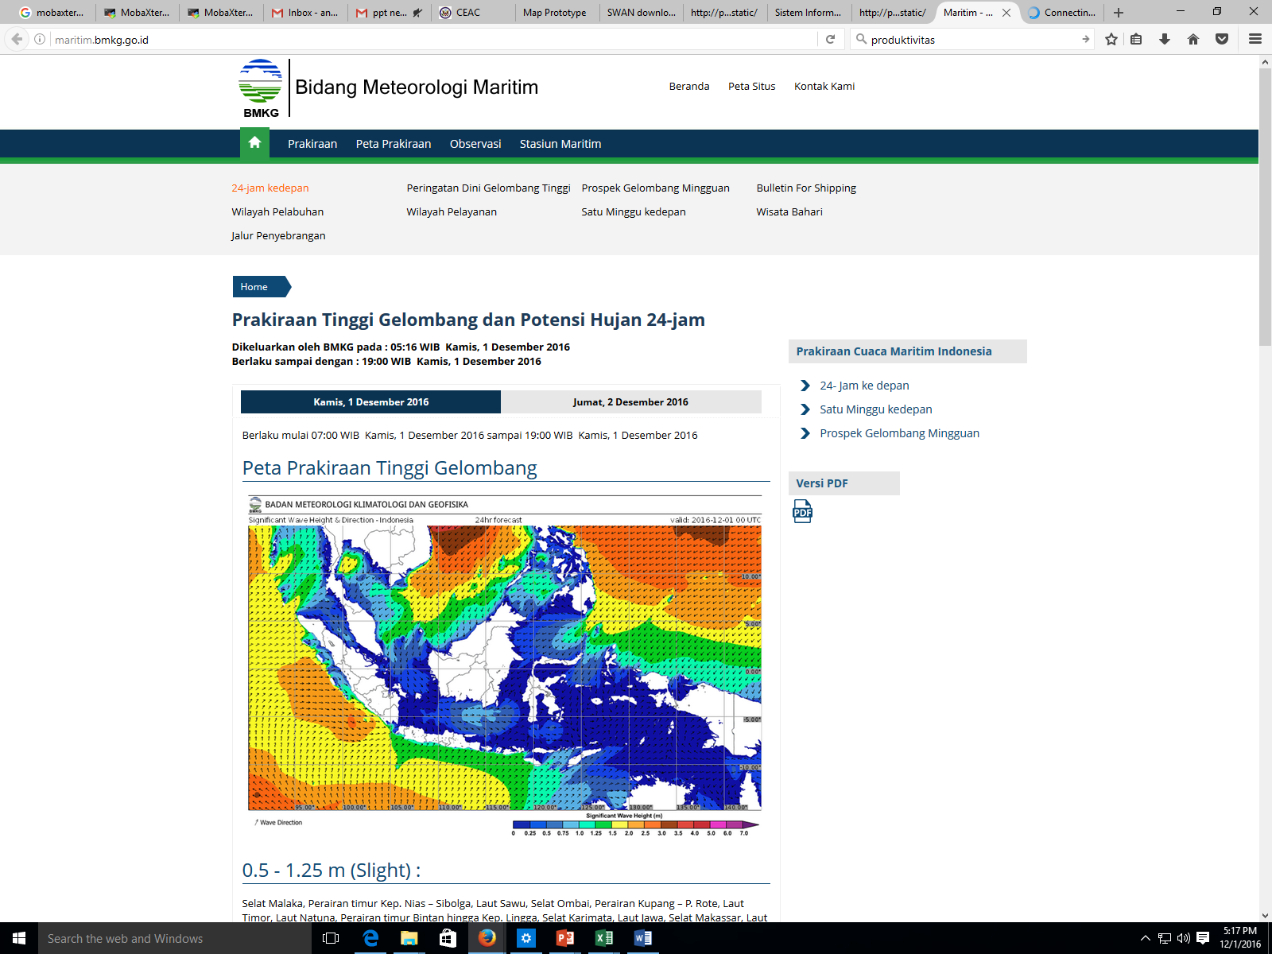
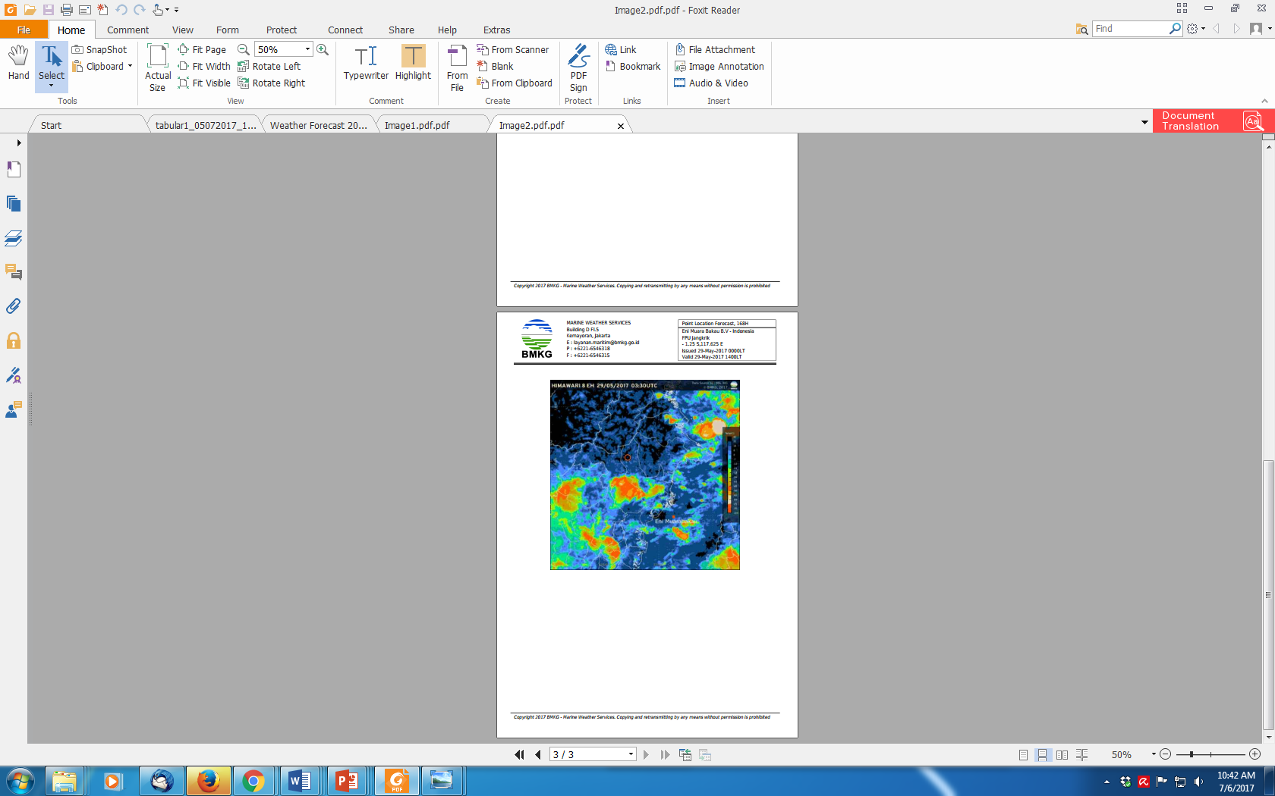
Installation and Download
WIDO HANGGORO

Slide 2
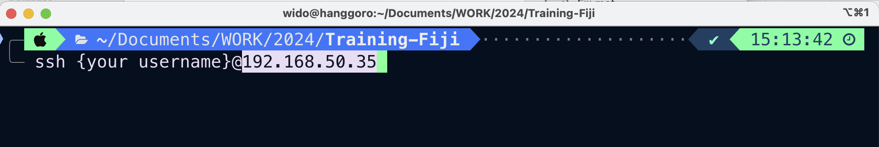
r installation
ssh to the server using mobaxterm
*please change ‘{your username}’ as your user id

Slide 3
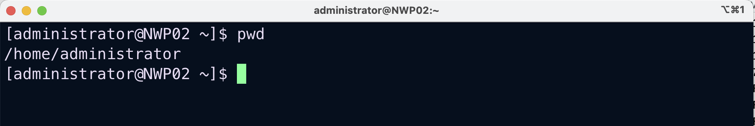
Make sure you are on the home folder
/home/{your username}

Slide 4
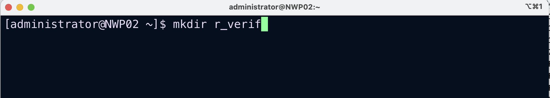
Create r_verif folder

Slide 5
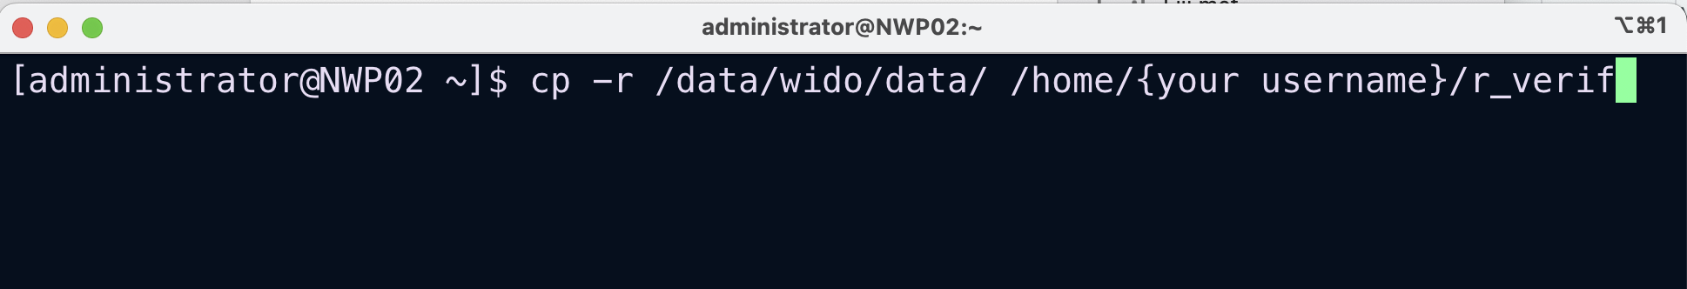
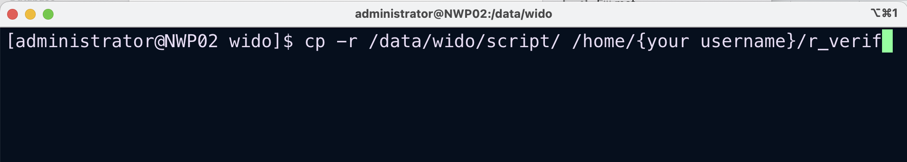
Copy both data and script directory to r_verif folder
*please change ‘{your username}’ as your user id

Slide 6
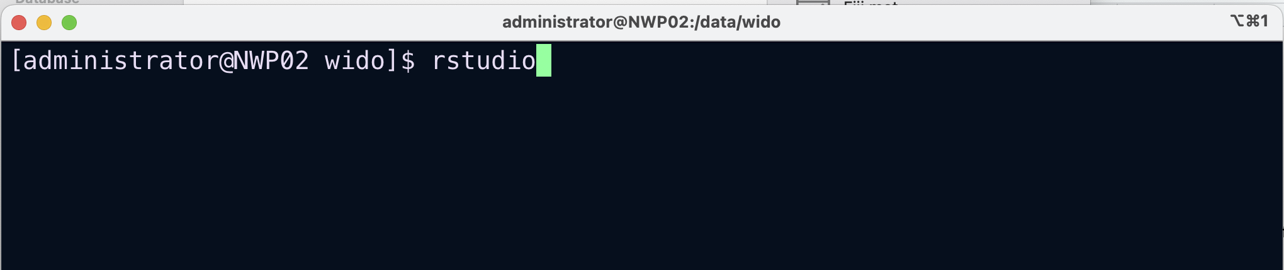
run rstudio

Slide 7
Or you may install both r and rstudio on your own machine
https://cran.r-project.org/bin/windows/base/
https://posit.co/download/rstudio-desktop/

Slide 8
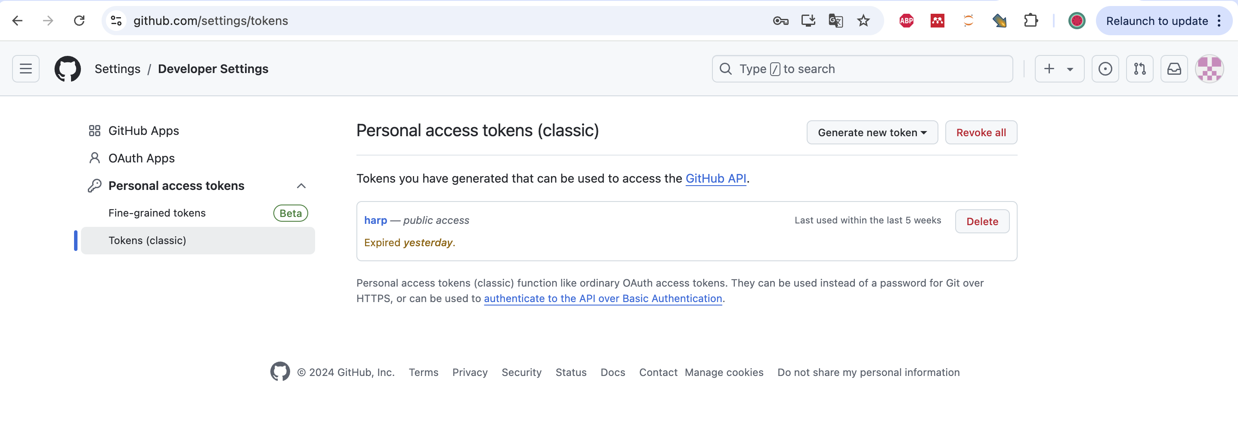
Harp Installation
Create github account
Login to your github account
and go to https://github.com/settings/tokens

Slide 9
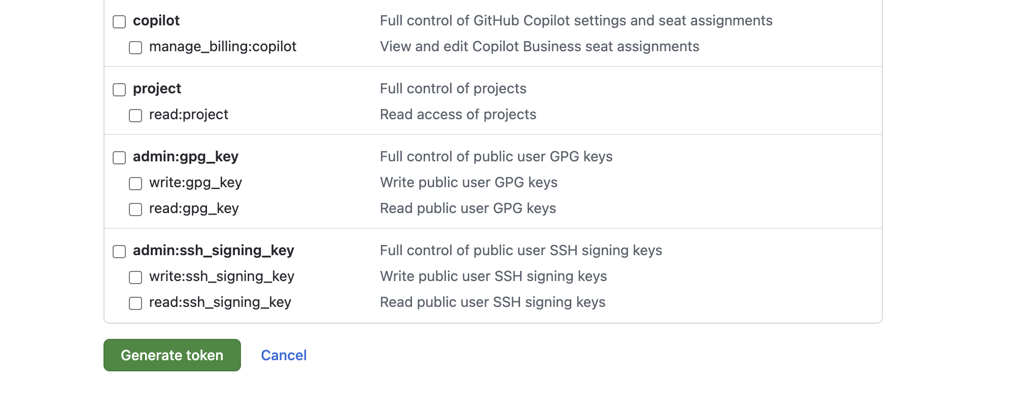
Generate new token (classic)
Token name (Note): e.g. Harp_install
Expiration: 90 days
Select: workflow, gist, user (all)
Generate/Update token

Slide 10
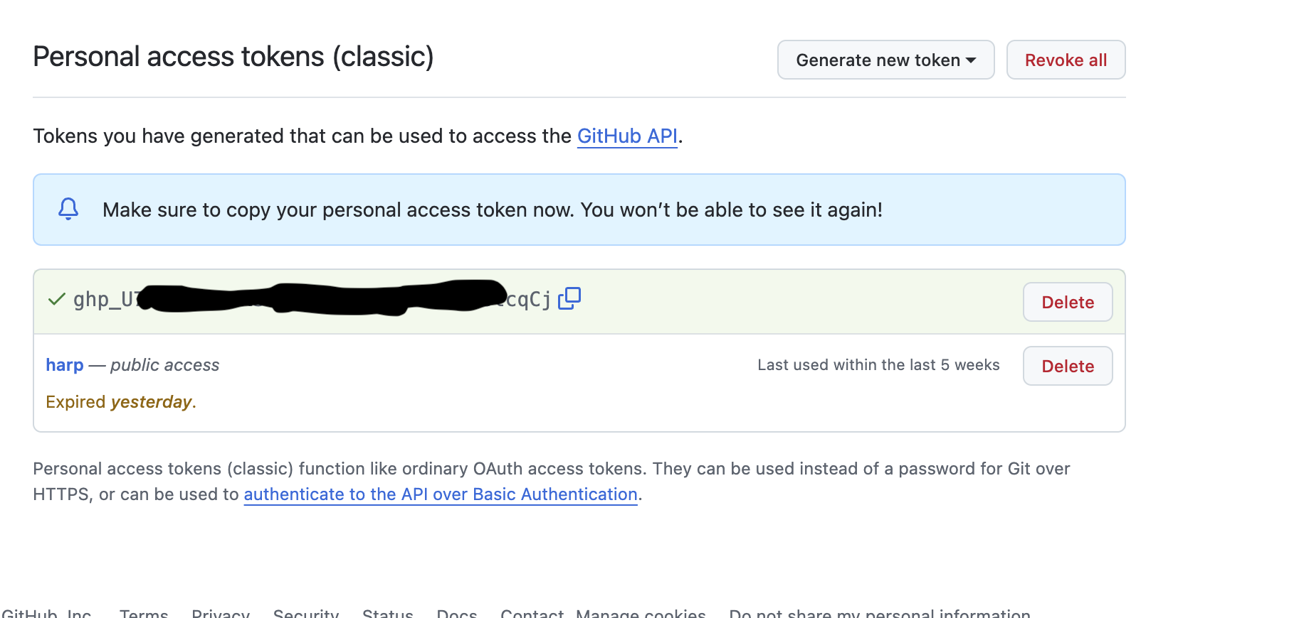
Copy token and add it to `.Renviron` file in your home directory

Slide 11
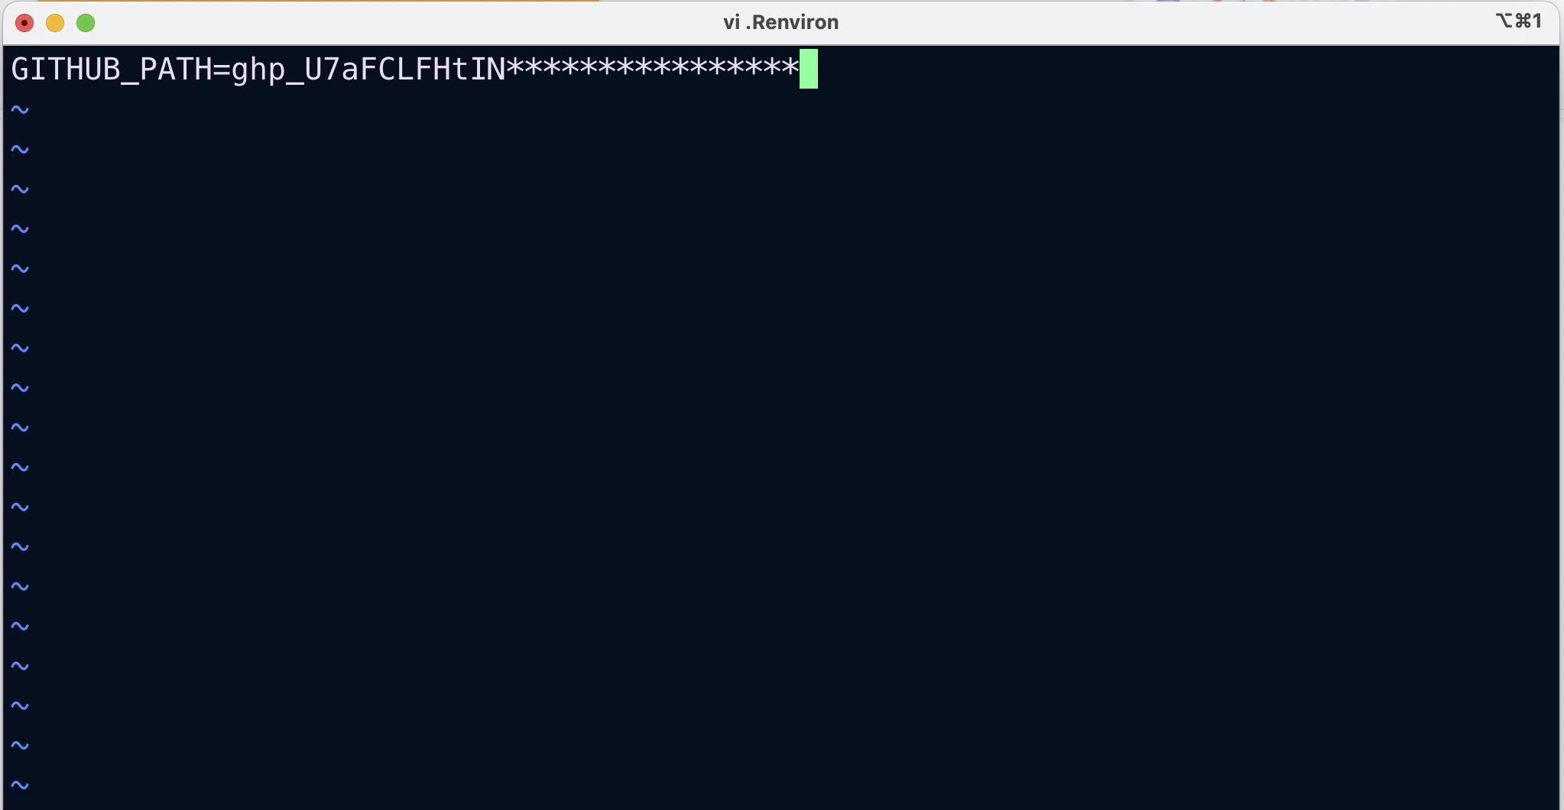
GITHUB_PAT= ghp_9*************************

Slide 12
Install linux packages
No need to do this (administrator will do this for you)
sudo dnf install eccodes-devel
sudo dnf install proj proj-devel
sudo dnf install netcdf-devel
sudo dnf install sqlite

Slide 13
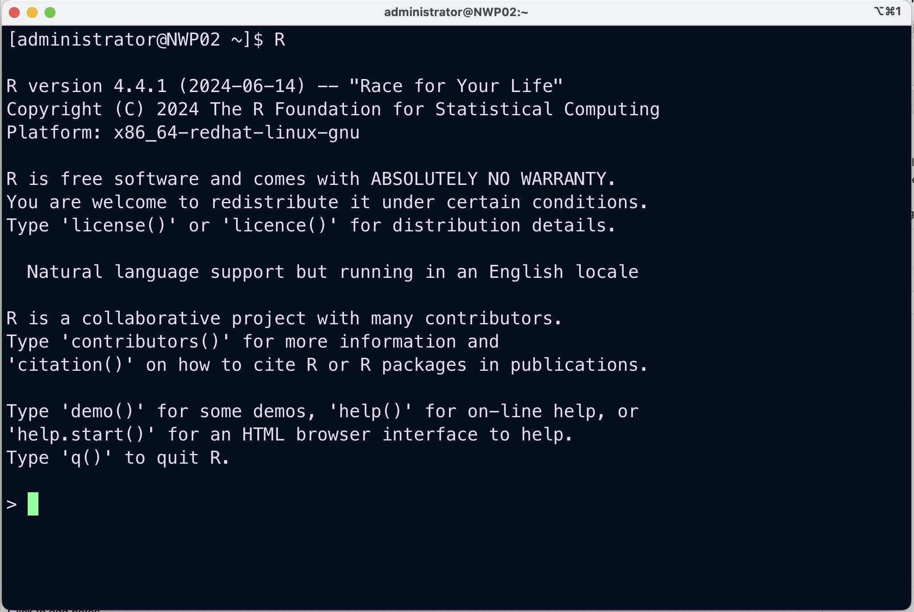
run R software by typing R (capital R) on your terminal

Slide 14
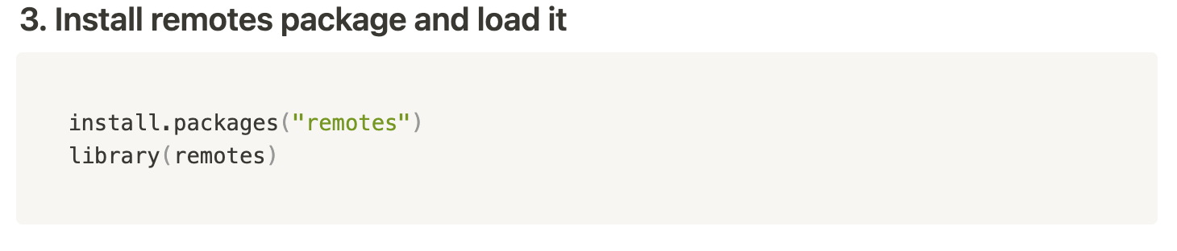
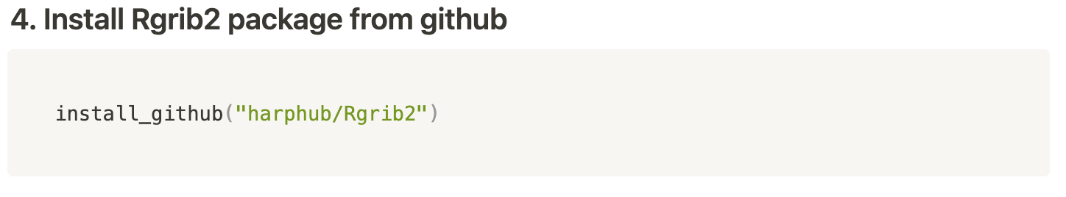
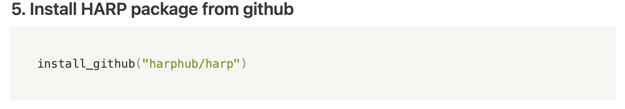
open your r apps

Slide 15
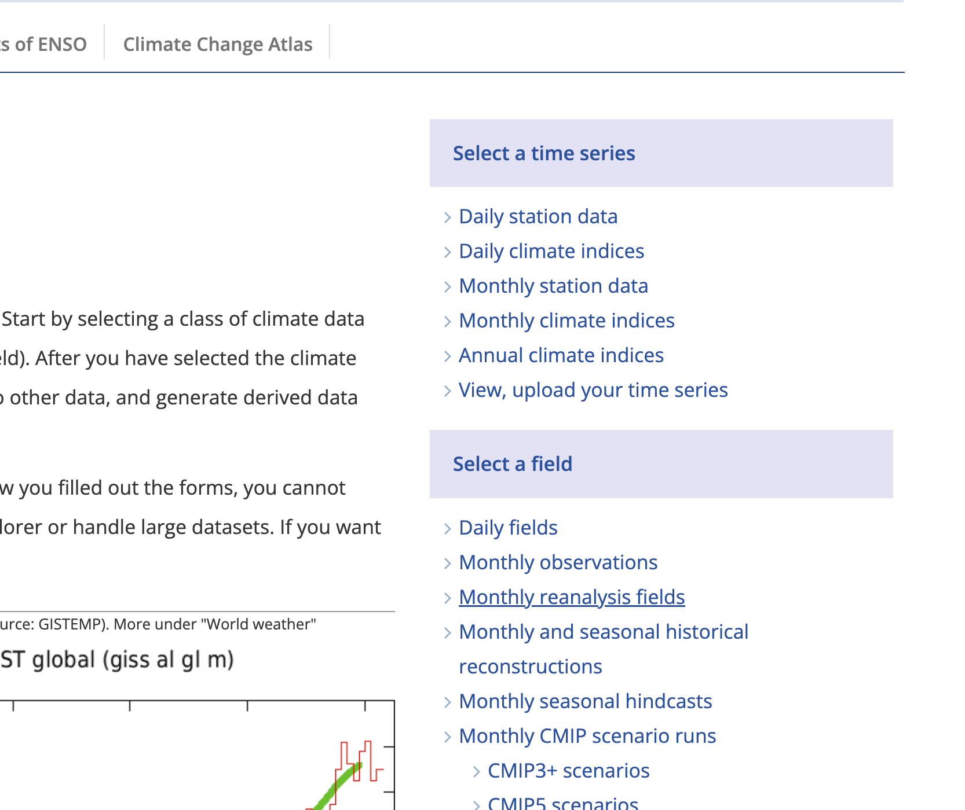
Download data from climate explorer
go to https://climexp.knmi.nl/start.cgi and choose daily fields

Slide 16
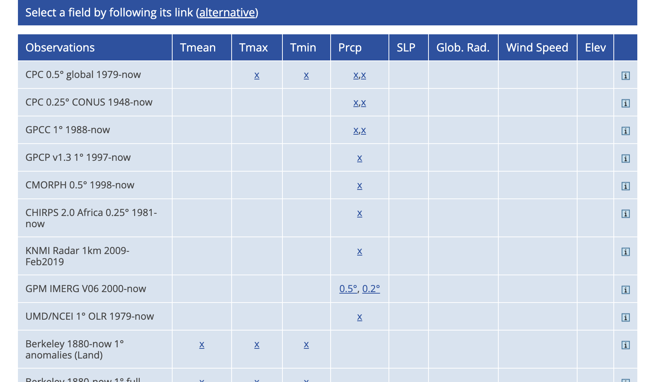
Select parameter

Slide 17
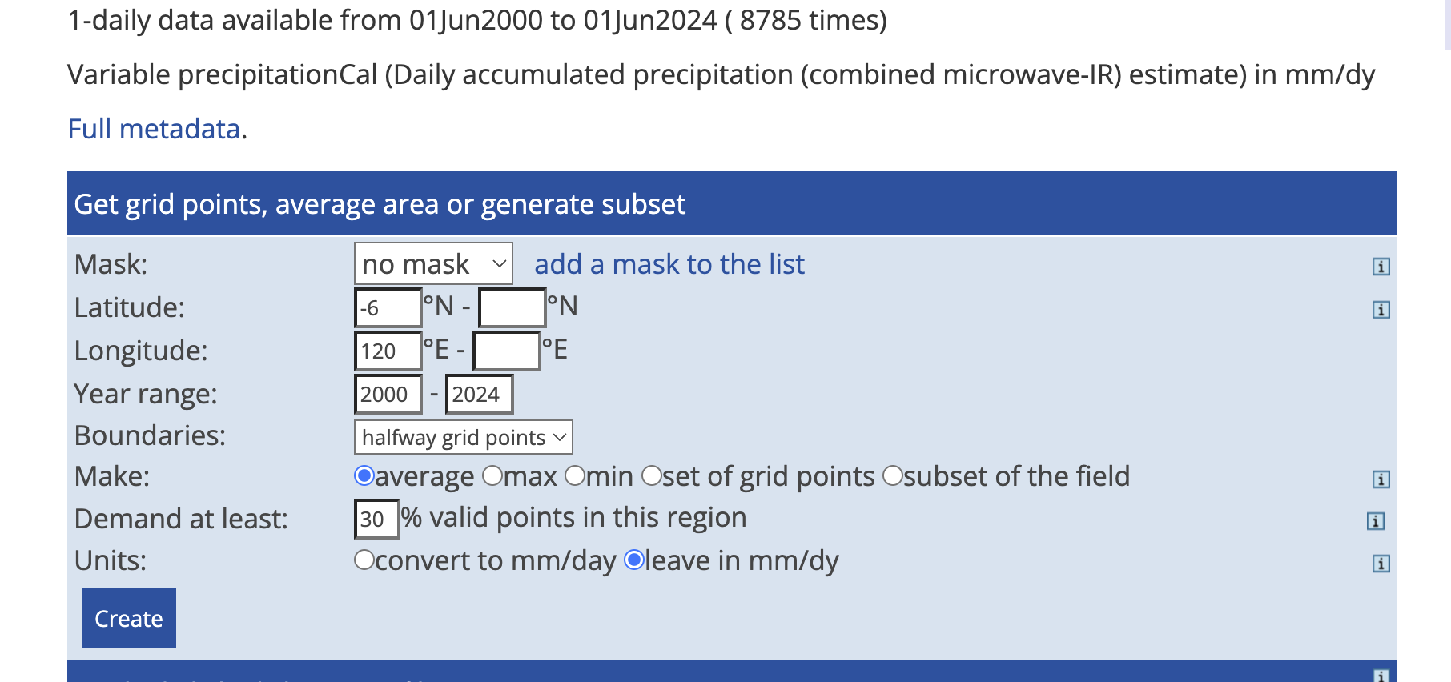
Select domain and time range for your data (for point data, only fill single latitude and longitude)
Click create

Slide 18
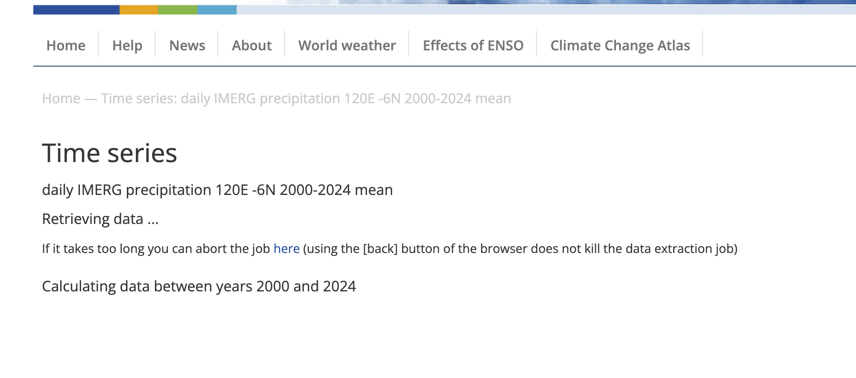
Wait while it’s retrieving the data

Slide 19
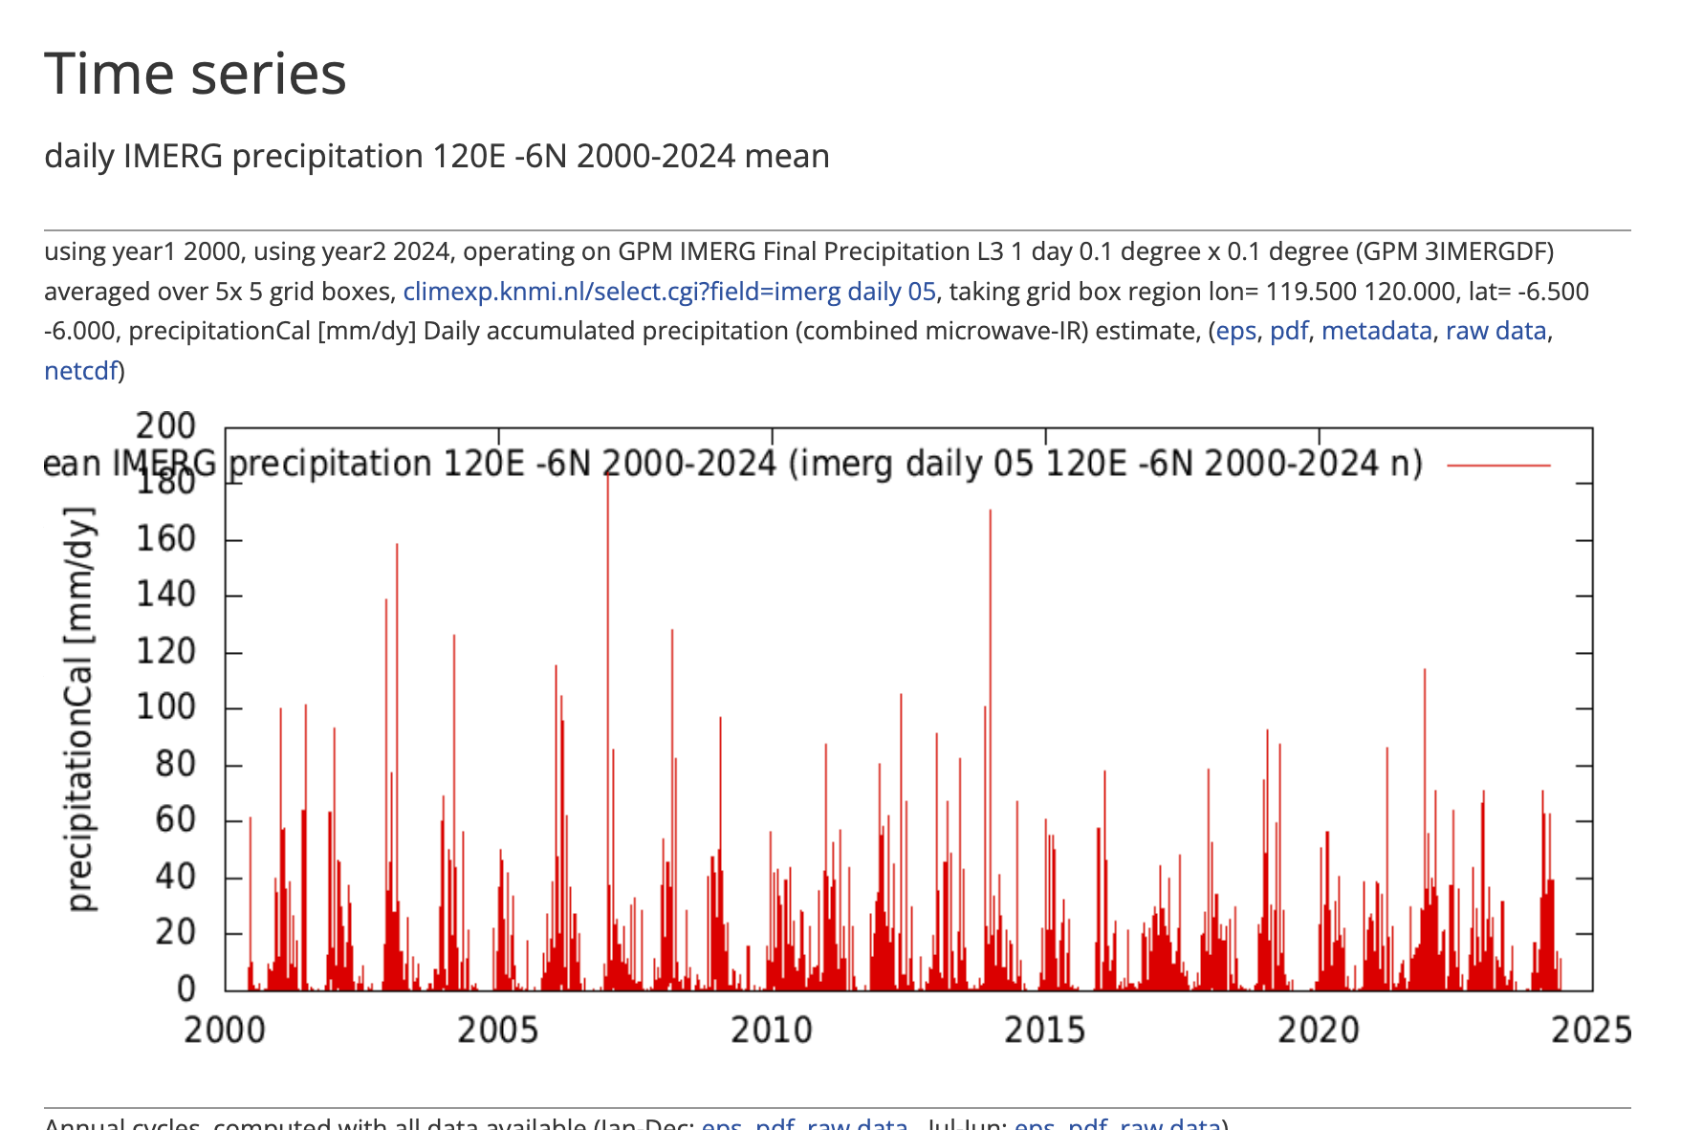
Select netcdf

Slide 20
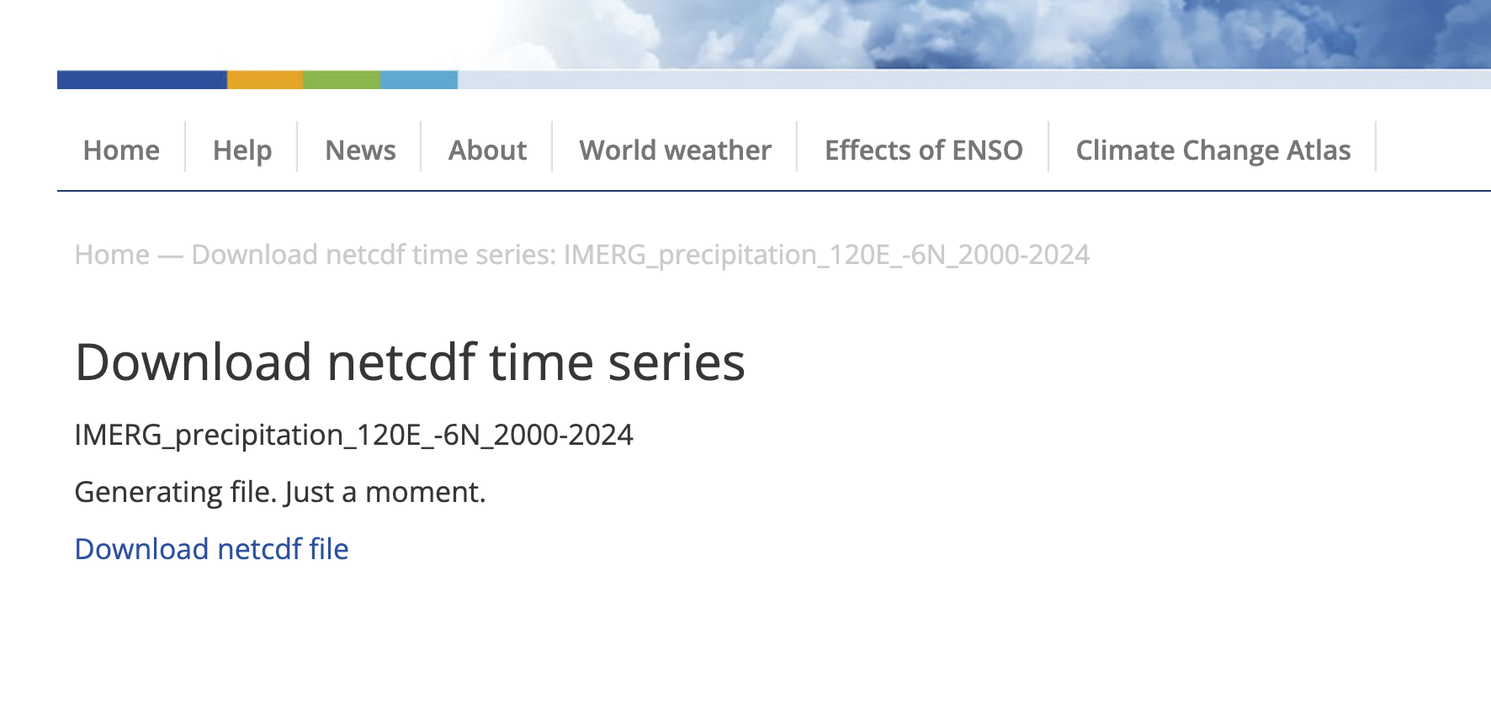
And lastly download data

Slide 21
Terima Kasih

